Slide 1
GatorMiner Demo
Featuring the completed issues ‘Frequencies of Categories of Words’ & ‘Frequency Analysis Word Cloud’

Slide 2
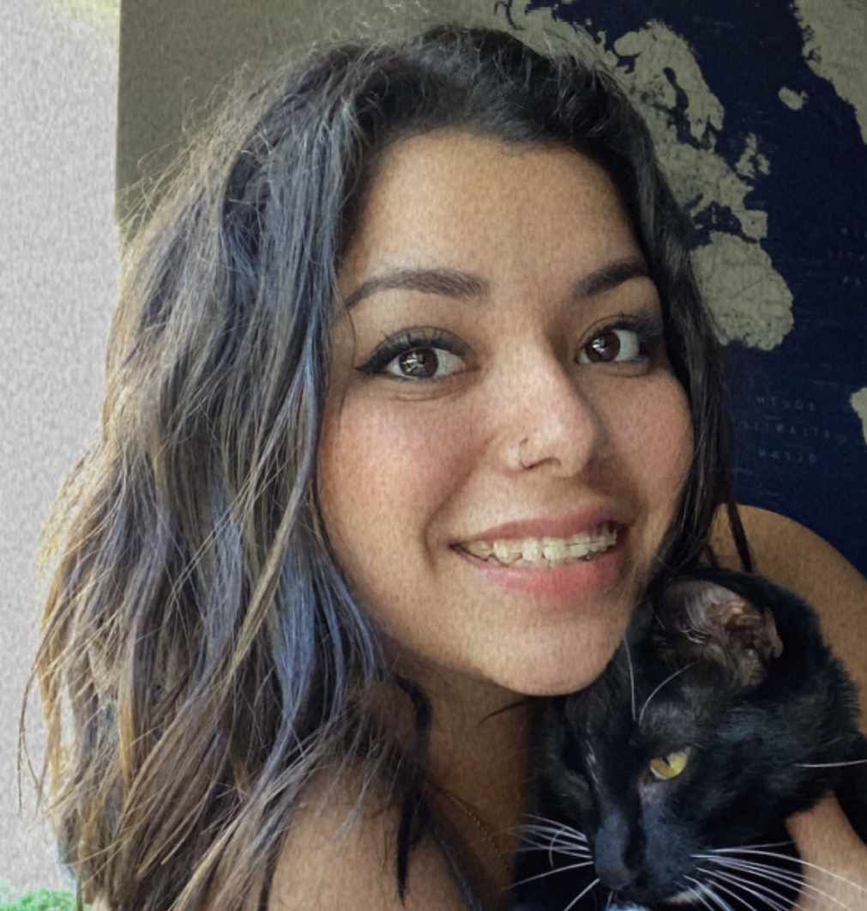
HELLO!
I am Adriana Solis
This demo shows the installation steps and functionality of my collaborative project, GatorMiner

Slide 3
Installation
1
These next slides will show the steps
used to install this project correctly

Slide 4
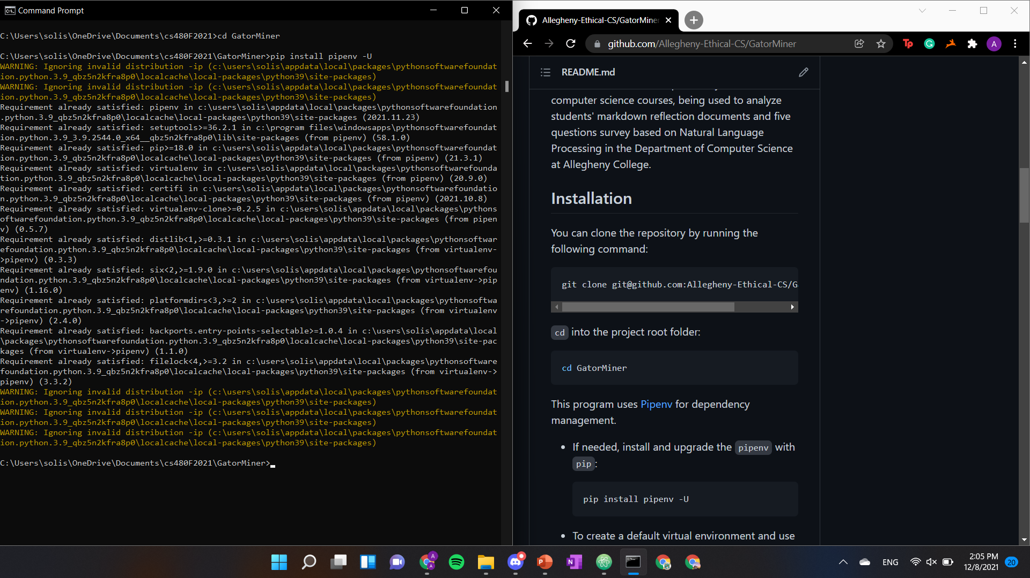

Slide 5
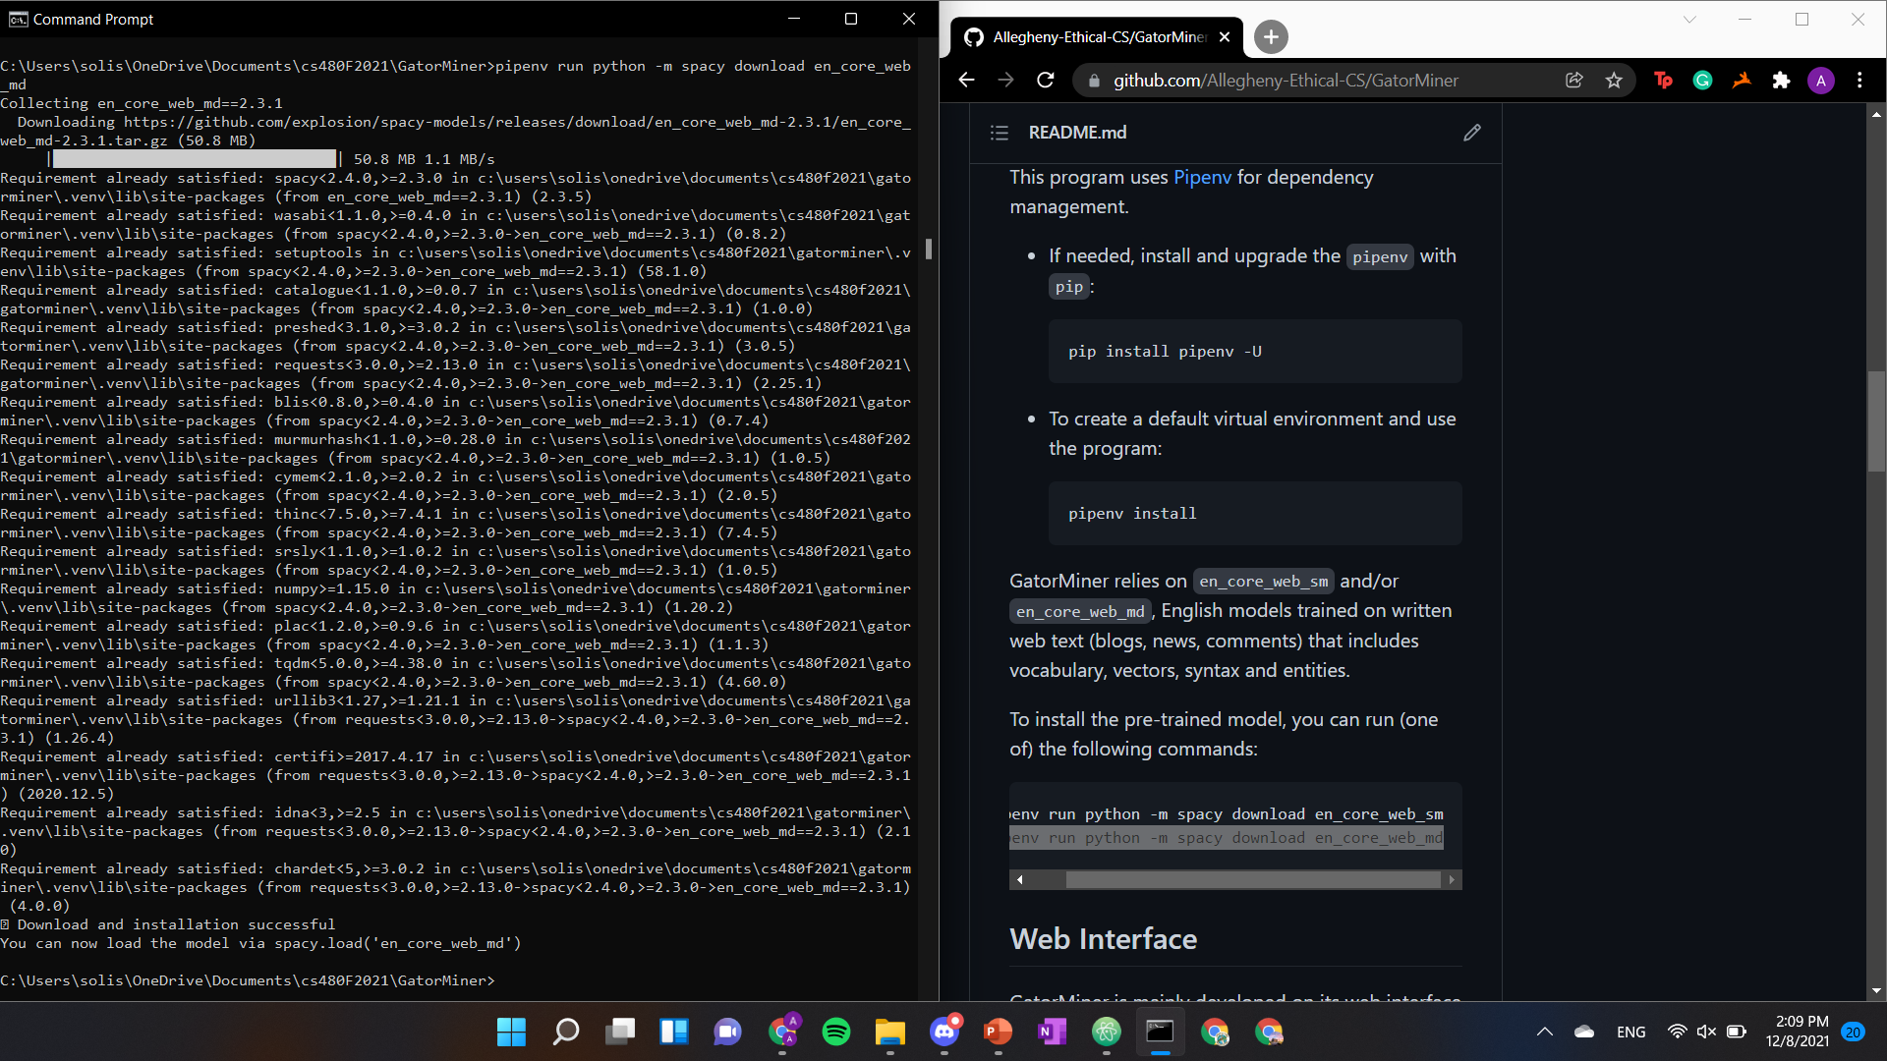

Slide 6


Slide 7
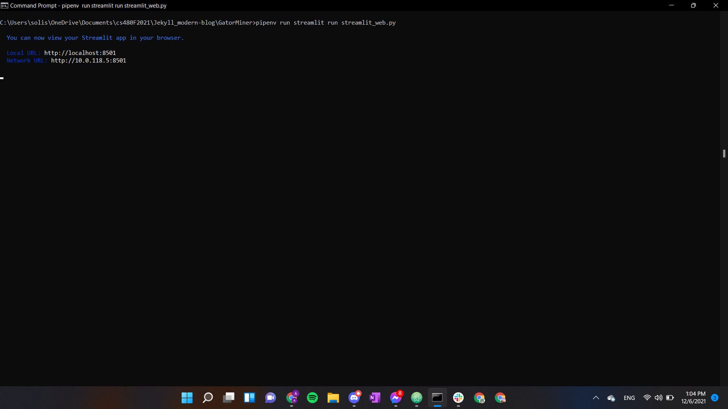

Slide 8
Features
1
These next slides will show the different
features one can use this program for

Slide 9
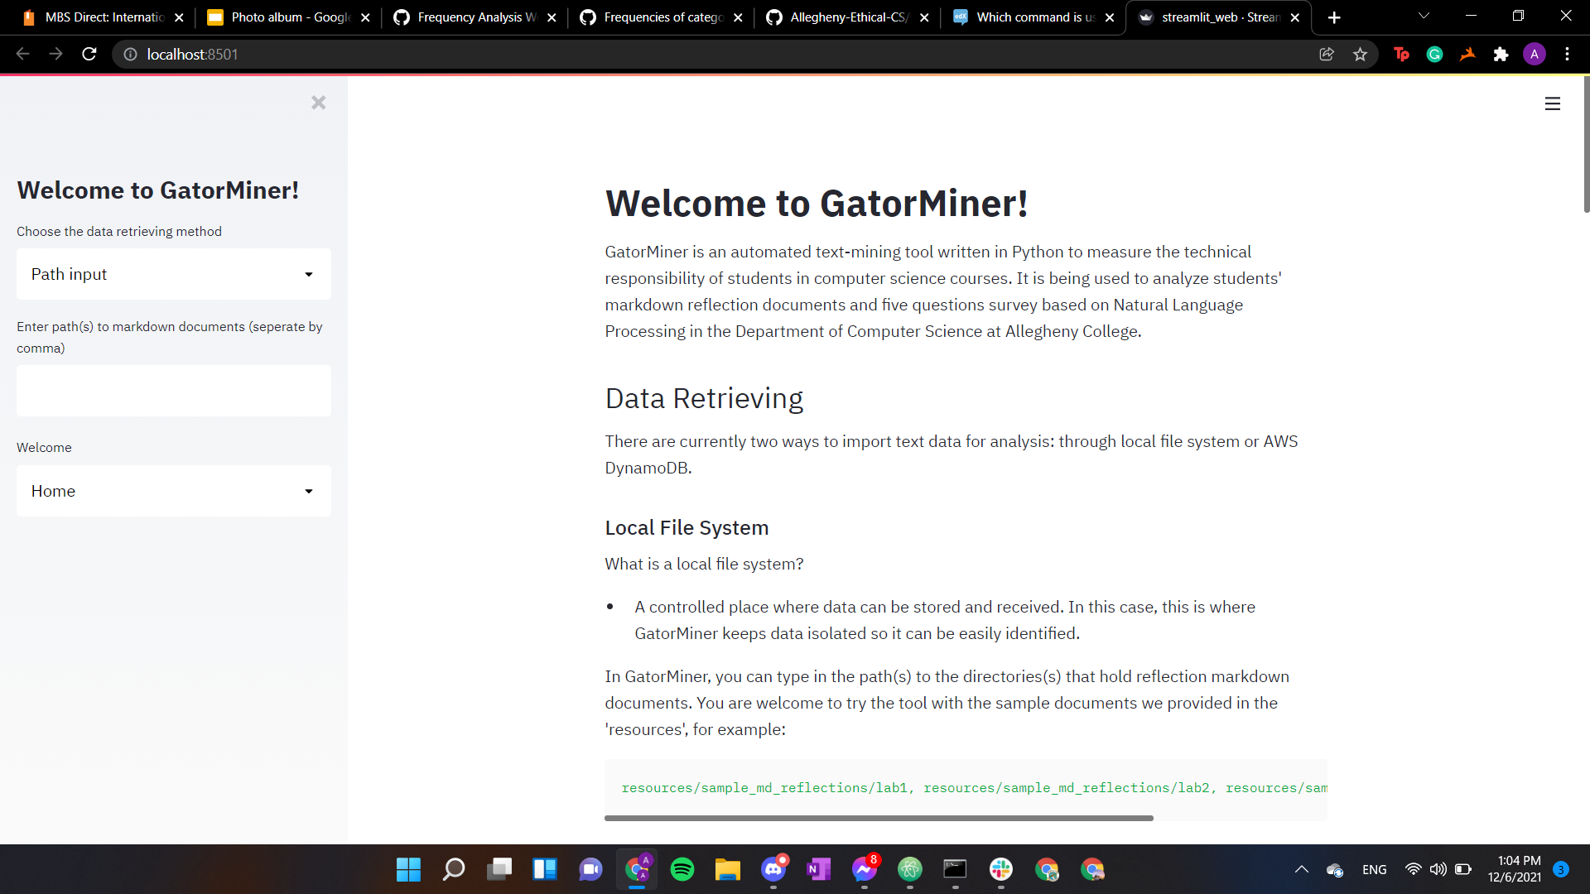

Slide 10
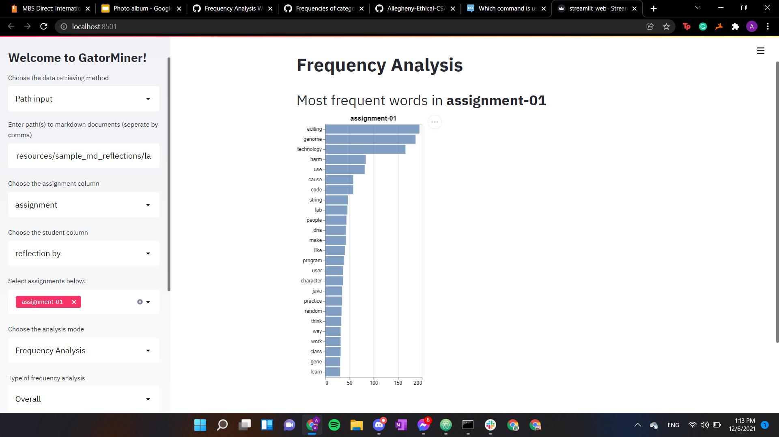

Slide 11
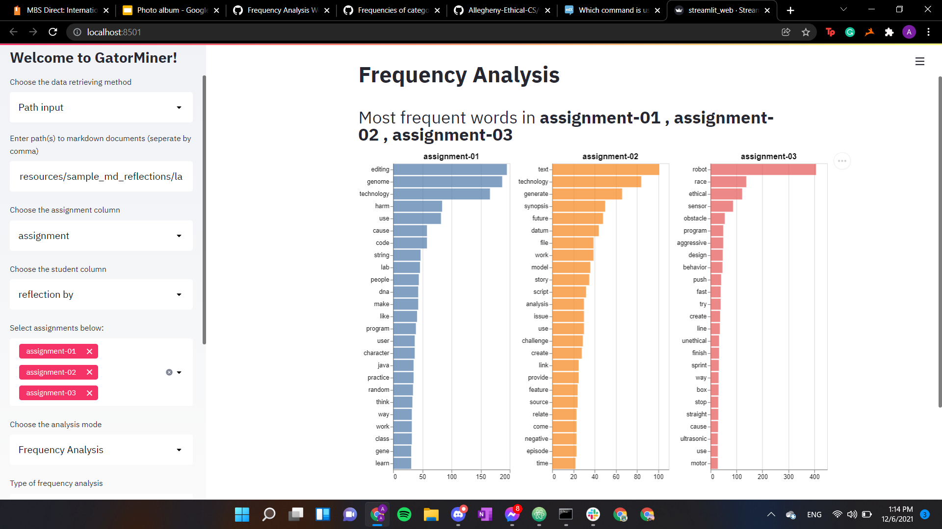

Slide 12
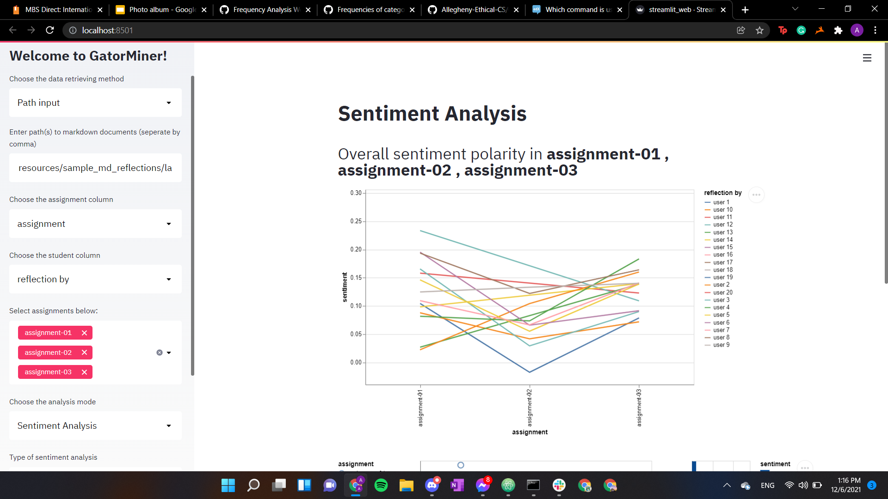

Slide 13
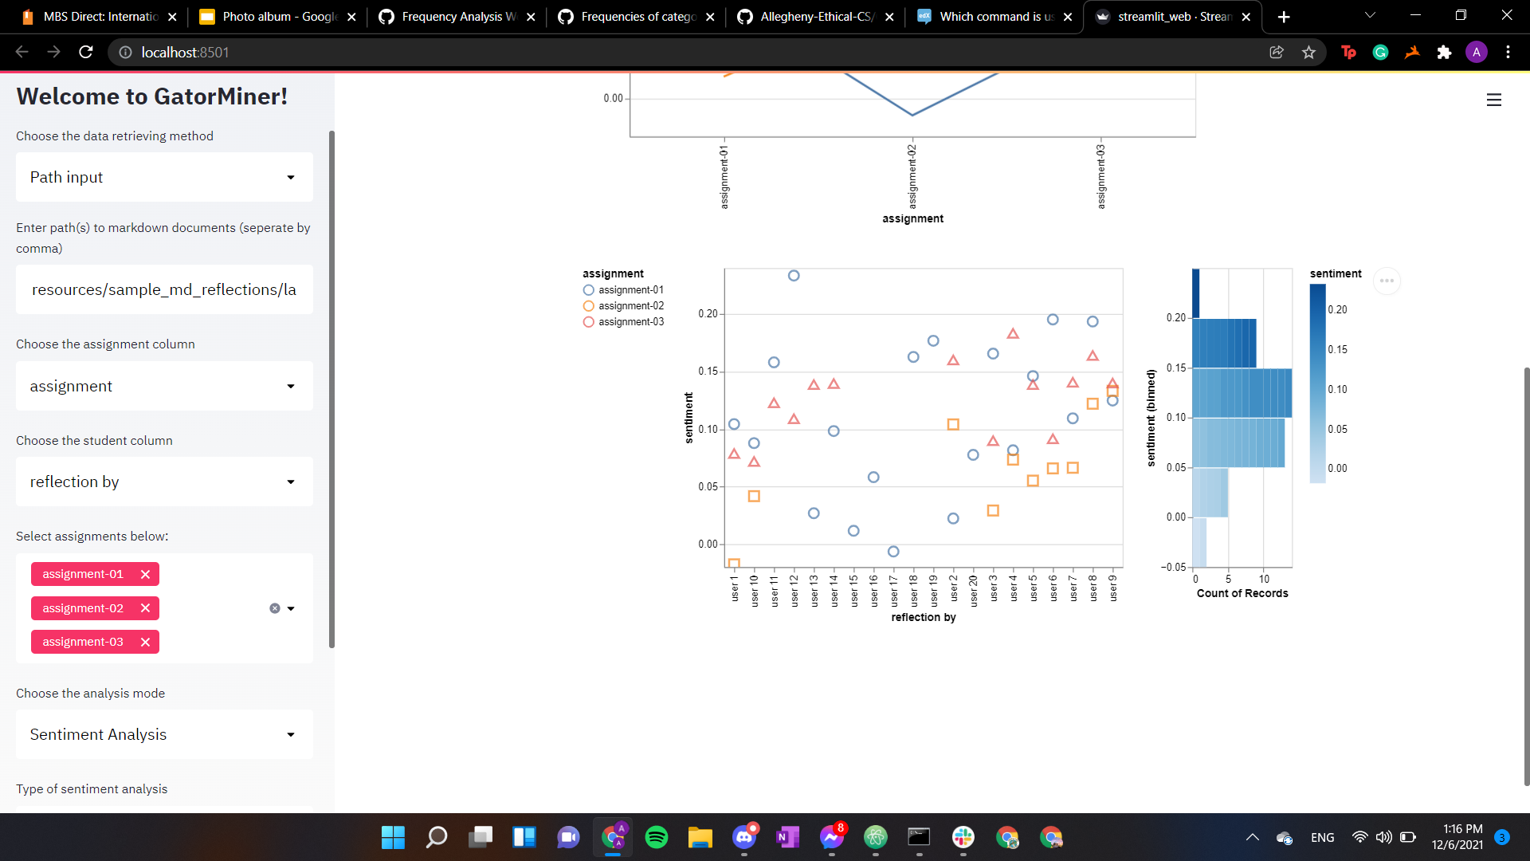

Slide 14
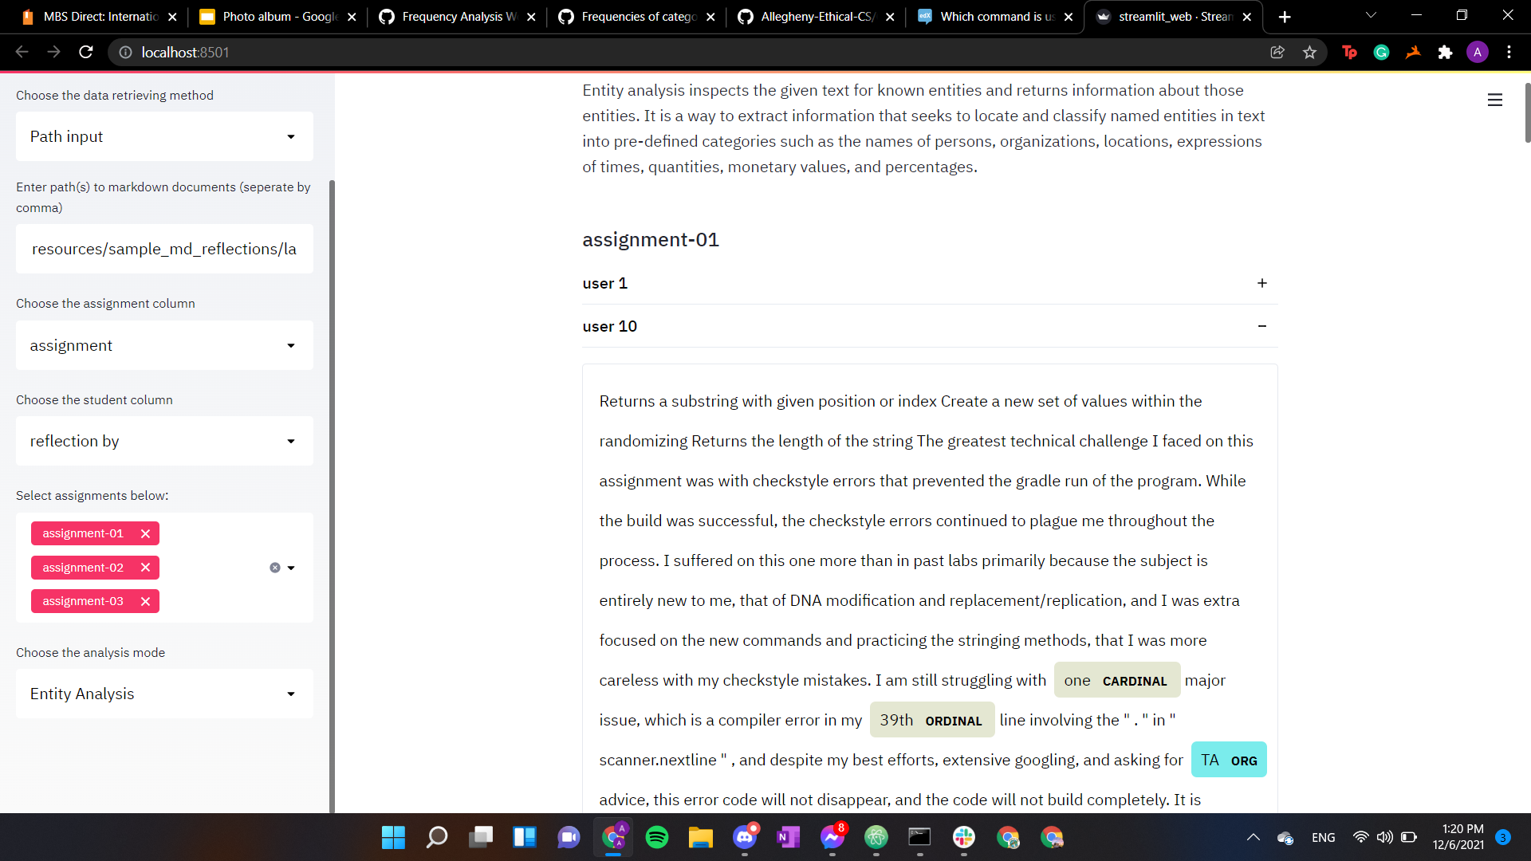

Slide 15
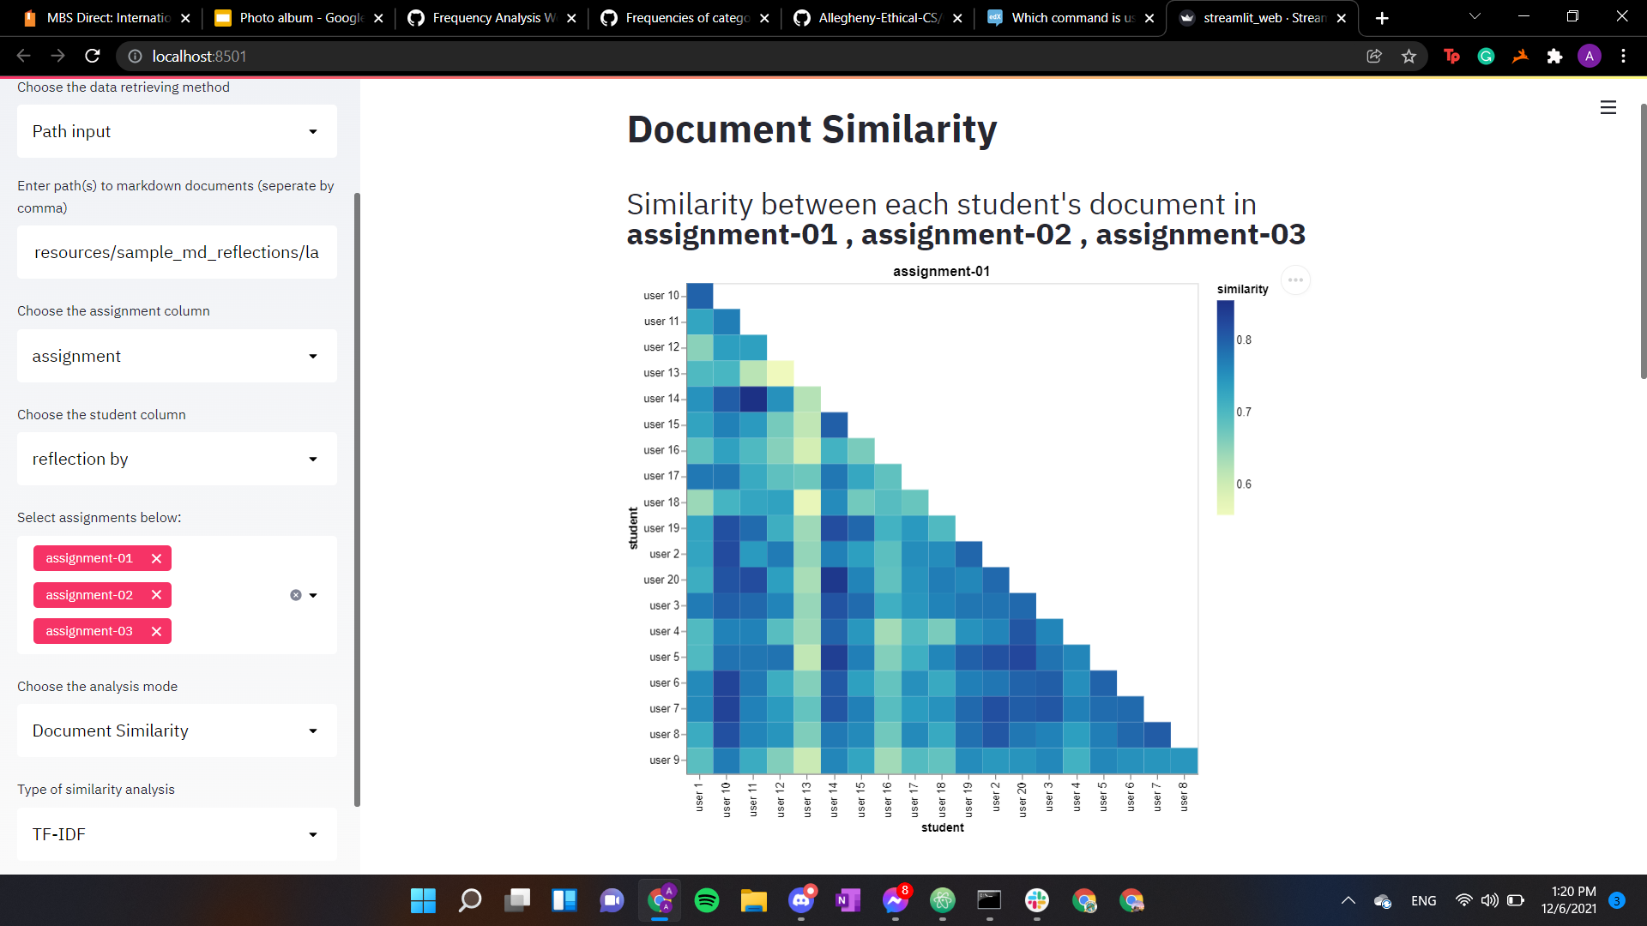

Slide 16
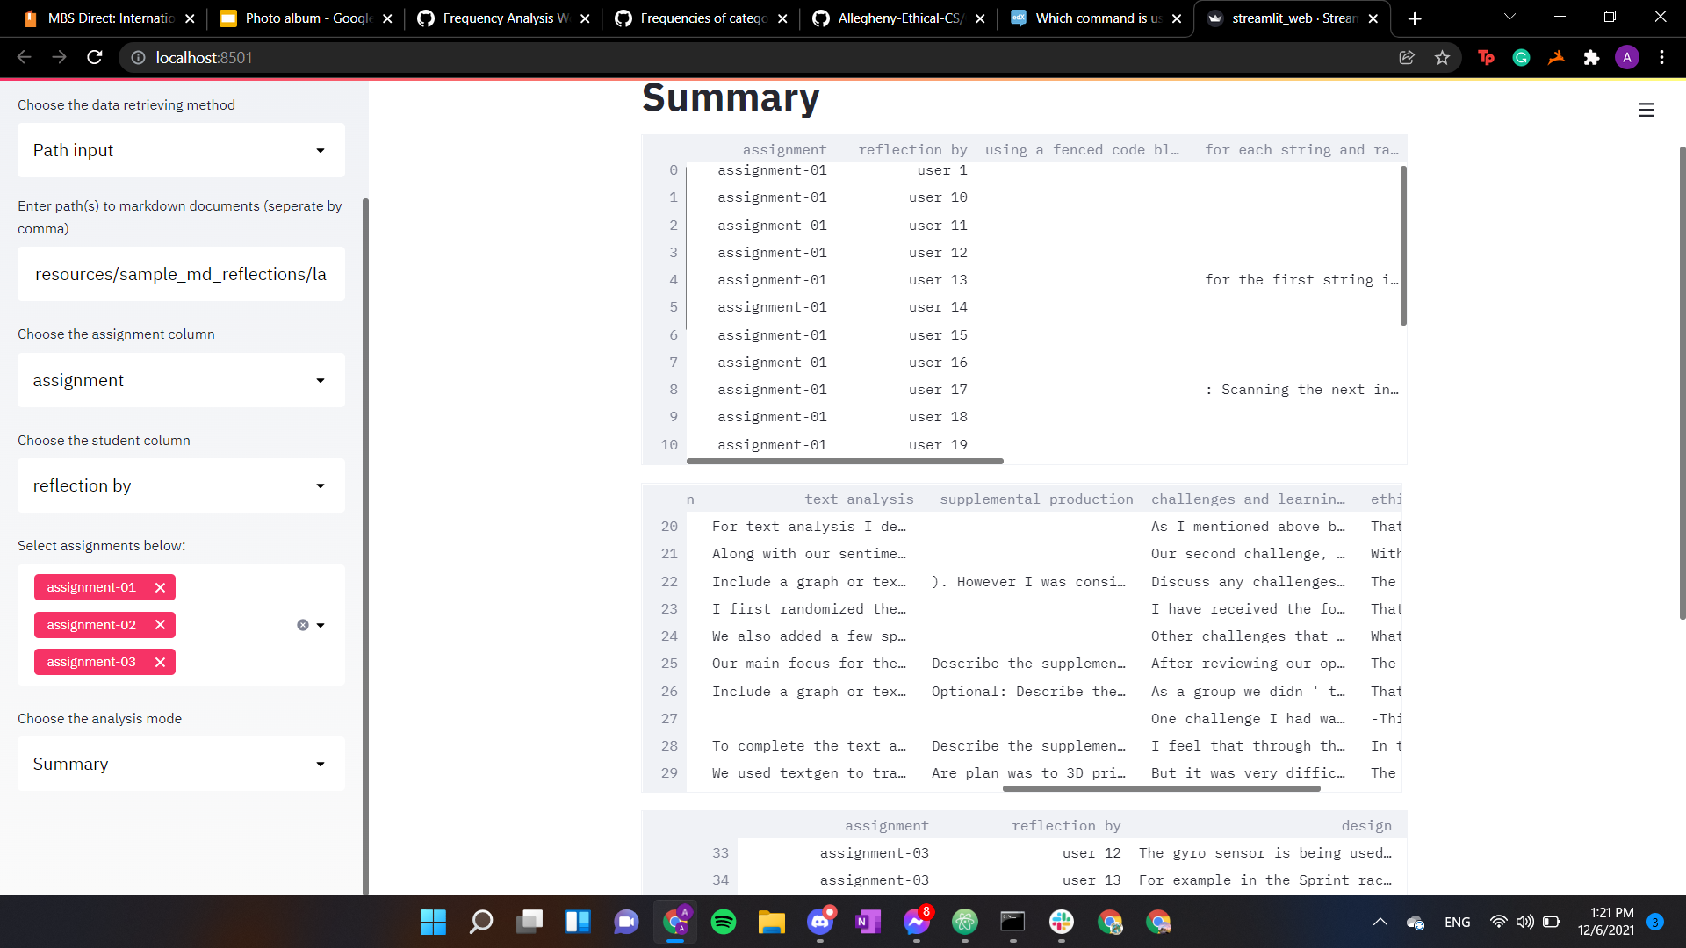

Slide 17
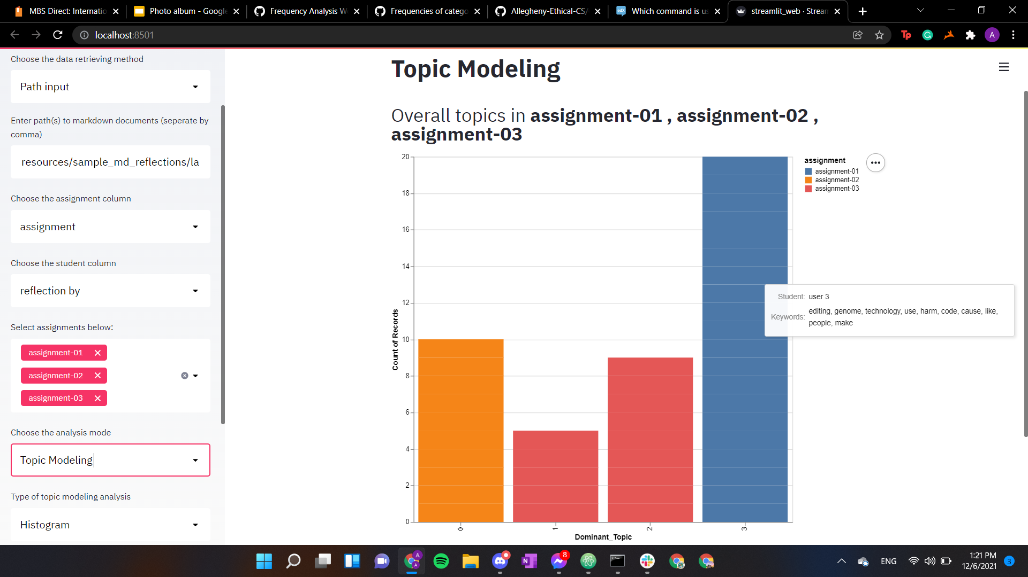

Slide 18
CMD Screen
1
This will show what the command prompt
will look like while running this program

Slide 19
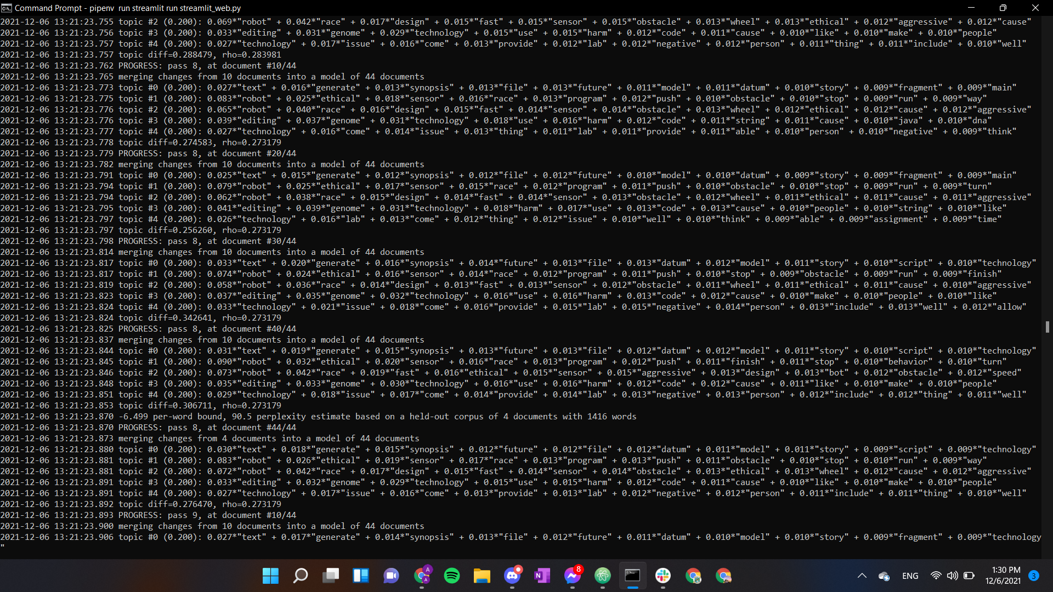

Slide 20
THANKS!
Check out the Projects page for more info!

